Slide 1

Application For Studying Vietnamese For Foreigners

Slide 2
Mr.Lại Đức Hùng
Supervisor 1
Mr.Nguyễn Thế Hoàng
Supervisor 2
Hồ Xuân Cường
Team Leader
Đặng Mạnh Tường
Team Member
Nguyễn Duy Anh
Team Member
Hồ Quang Bảo
Team Member

Slide 3
Project Overview
AGENDA
Diagram
Screen Prototype

Slide 4
AGENDA
_____
01
02
03
05
Project Overview

Slide 5
PROJECT
OVERVIEW
_____
Current
Problem
Our
Solution

Slide 6
AGENDA
_____
02
01
03
Diagram

Slide 7
DIAGRAM
_____
Use Case
Diagram
ERD
Diagram

Slide 8
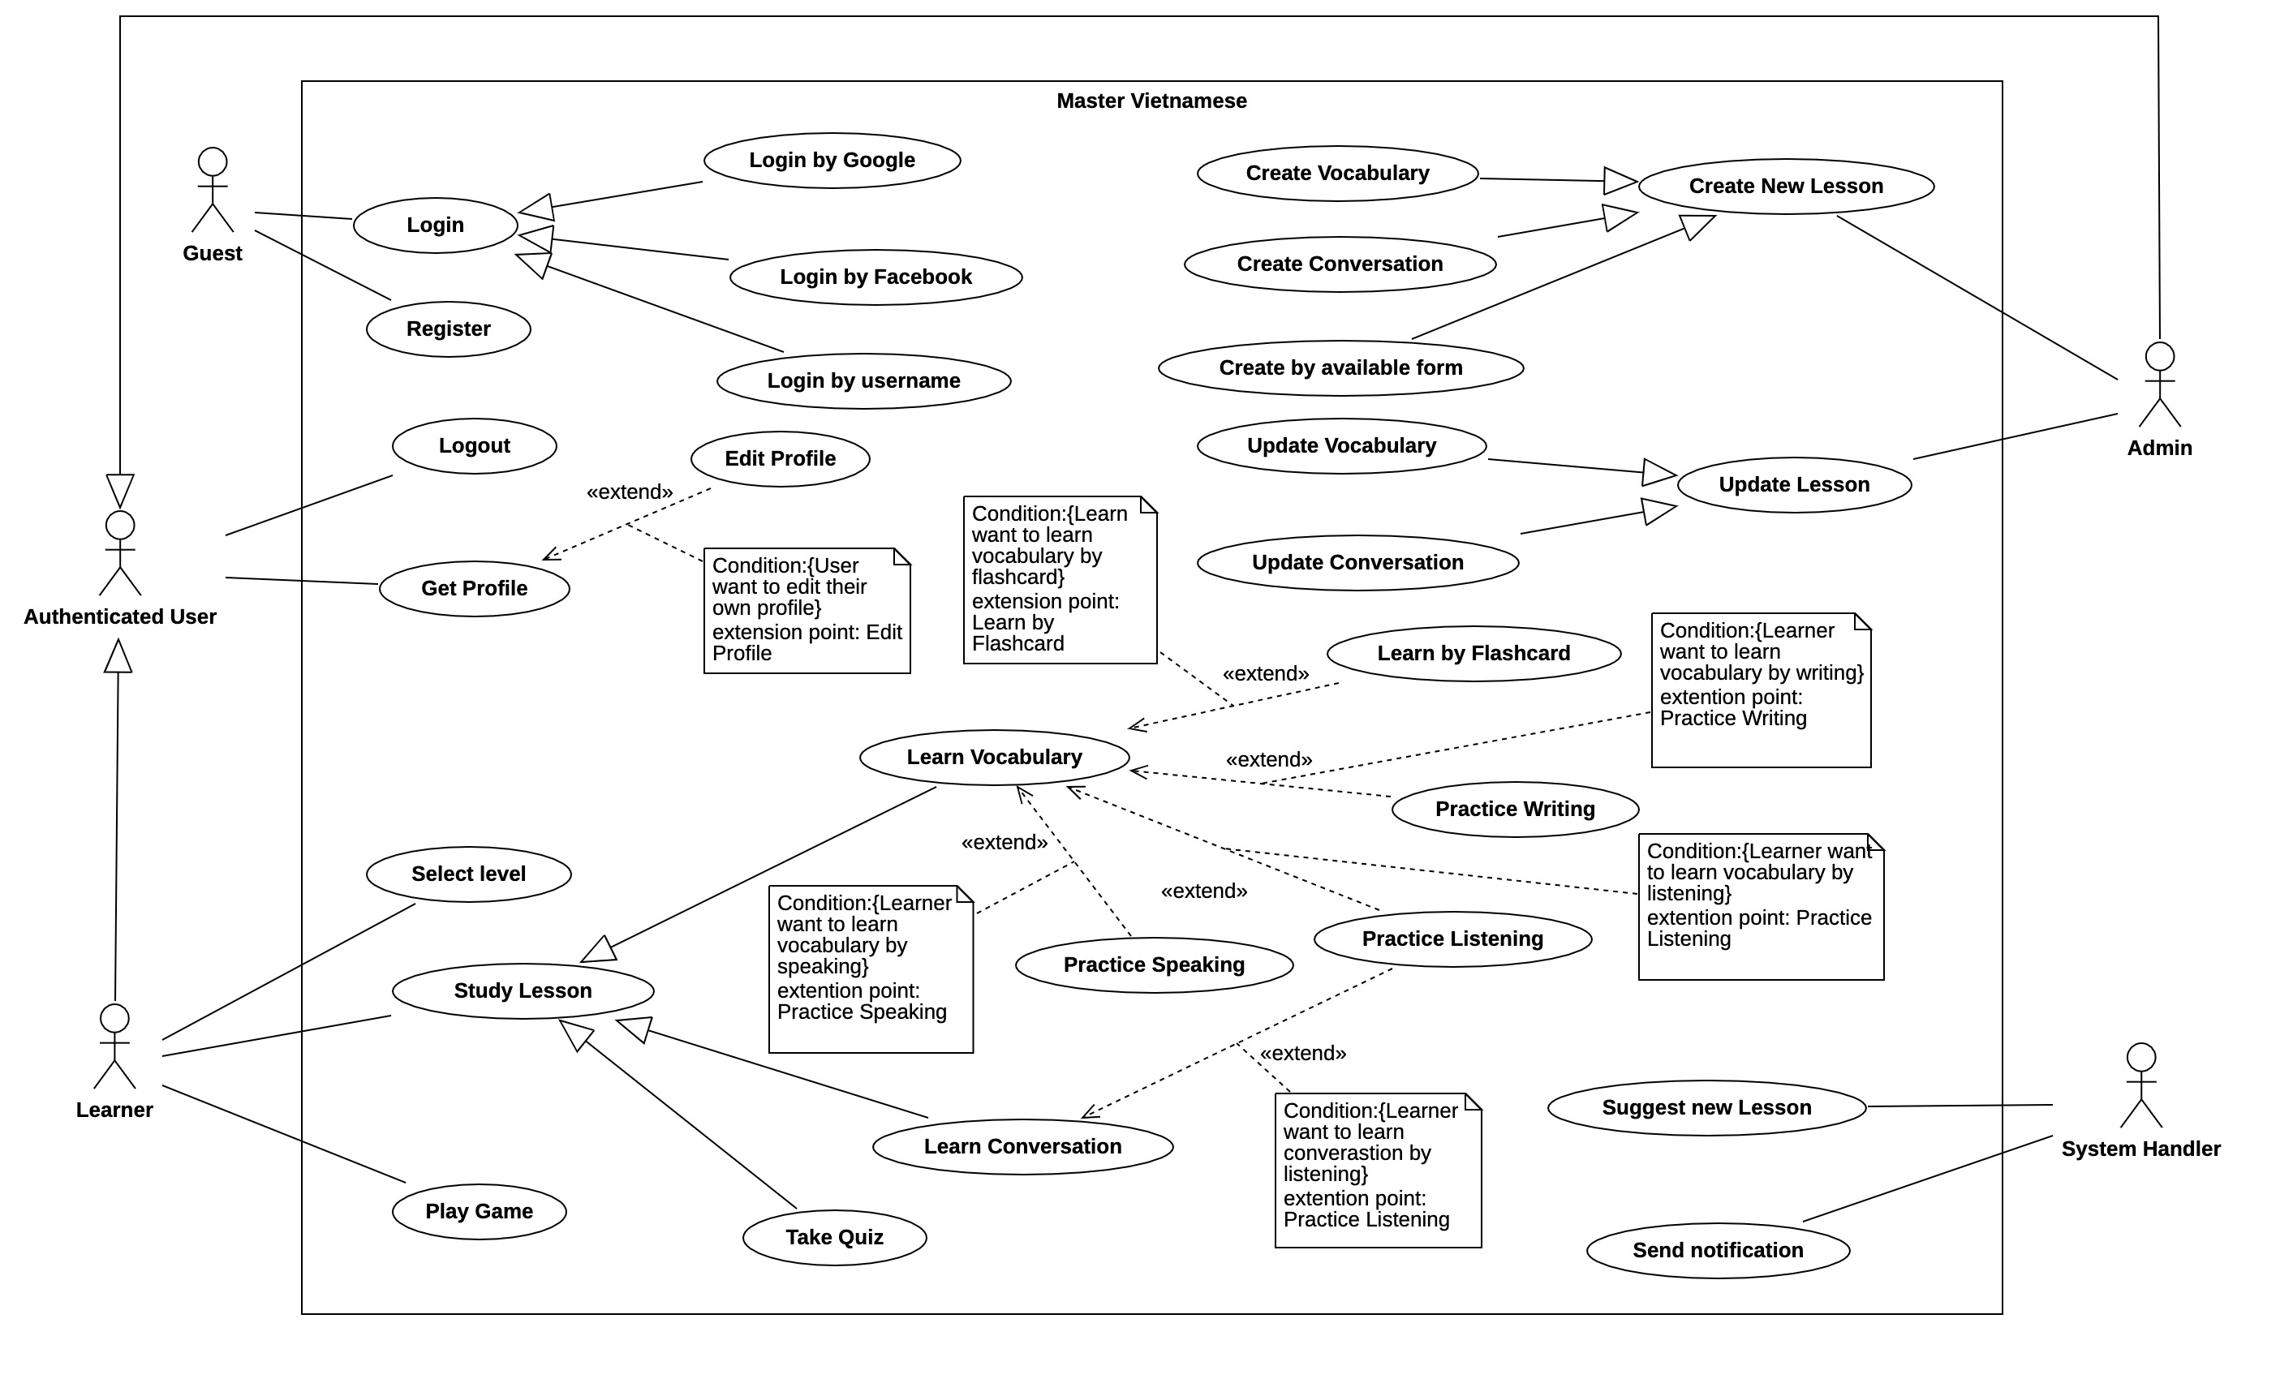
USE CASE DIAGRAM
_____
ERD
Diagram

Slide 9
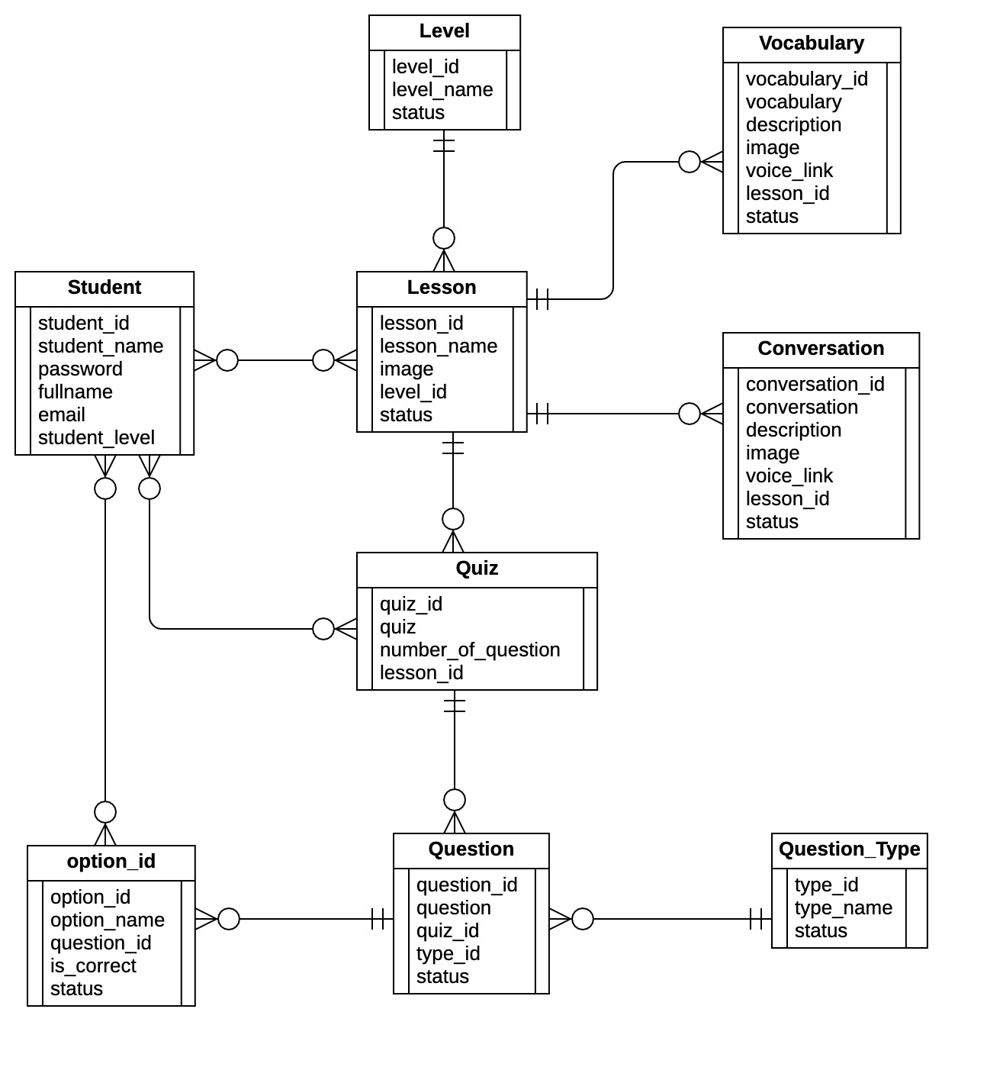
ERD DIAGRAM
_____
ERD
Diagram

Slide 10
AGENDA
_____
03
01
02
Screen Prototype

Slide 11

Q&A

